Slide 1
Prediction of Chronic Kidney Disease

Slide 2
DATA SET
CONTEXT: This data set comprises of data that is observed during the early stage of Chronic Kidney Disease.
SOURCE: We are using the Chronic_Kidney_Disease dataset from UCI Machine Learning Repository.
https://archive.ics.uci.edu/ml/datasets/Chronic_Kidney_Disease

Slide 3
Description
The data set consists of 400 entries and 25 variables.
The variables of the data set are of numerical and nominal type.
These variables are observed from India.
It consists of entities which are used for predicting the presence of the chronic kidney disease.

Slide 4
Unit of Analysis
The unit of analysis for the dataset associated with our final project is the presence of chronic kidney disease in the individuals who were involved in the observation during the data collection.

Slide 5
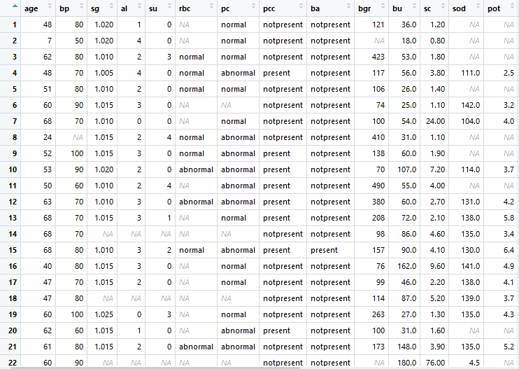
Data tidying and transformations
The data set consisted of ? For the unknown value these were replaced by NA

Slide 6
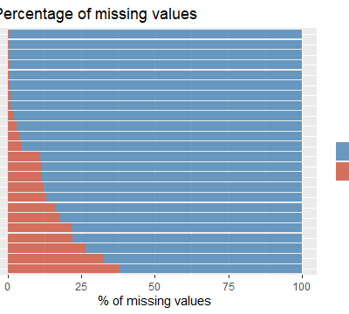
Percentage of missing values

Slide 7
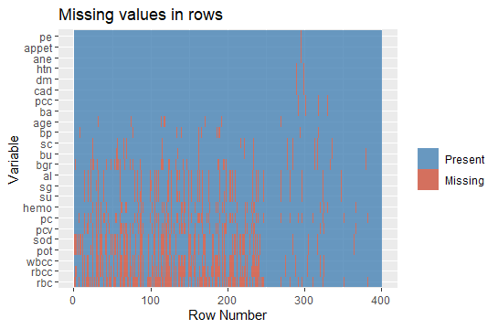
Visualization of each missing values in rows

Slide 8
Transformation

Slide 9
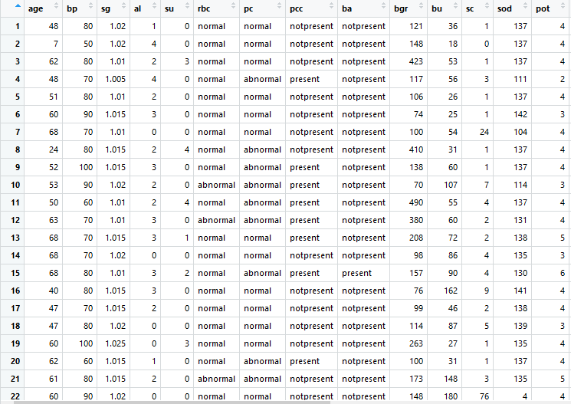
Transformed data

Slide 10
EXPLORATORY VISUALIZATION

Slide 11
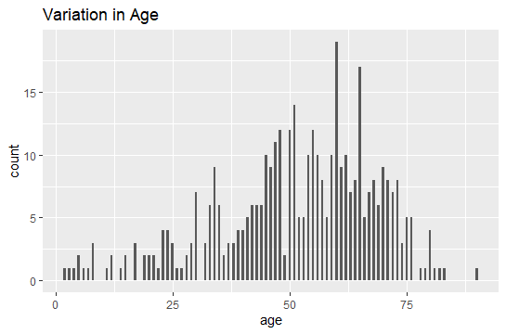

Slide 12
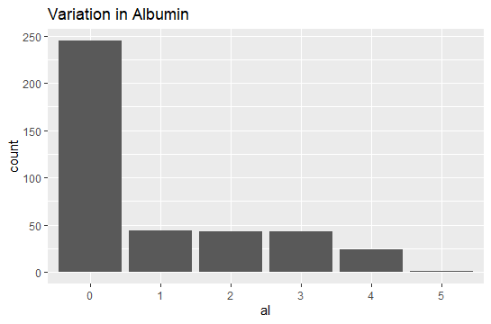

Slide 13
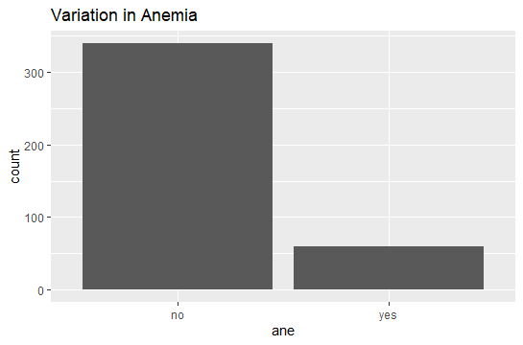

Slide 14
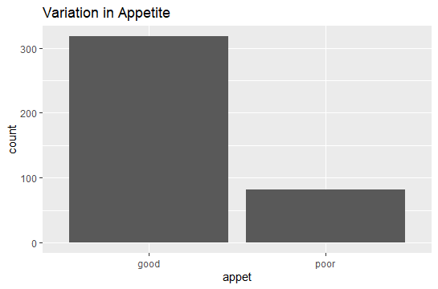

Slide 15
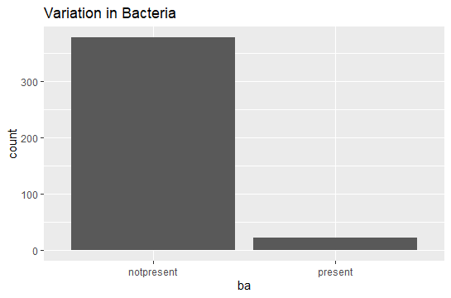

Slide 16
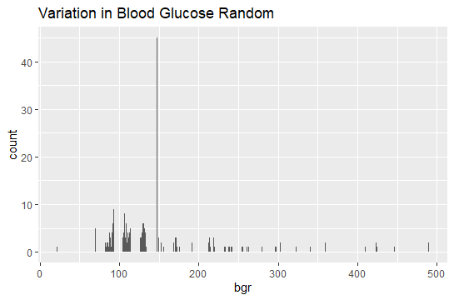

Slide 17
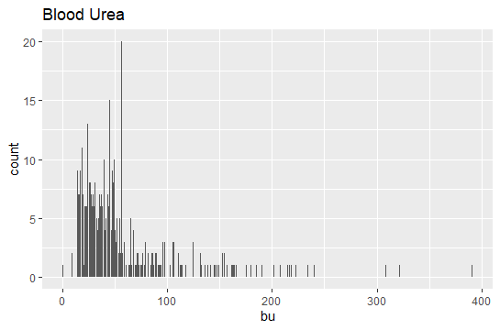

Slide 18
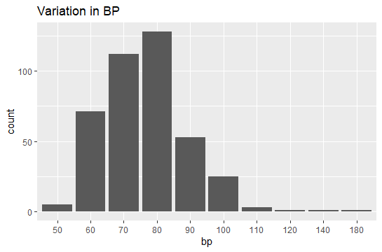

Slide 19
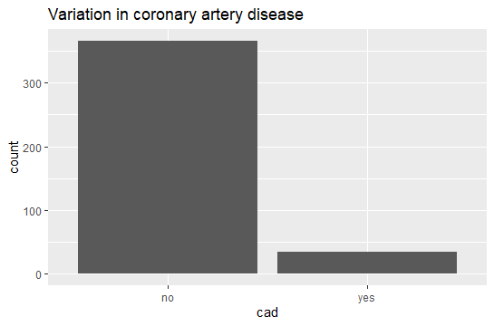

Slide 20
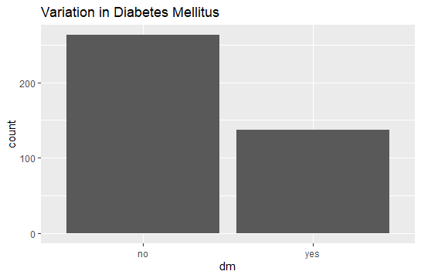

Slide 21
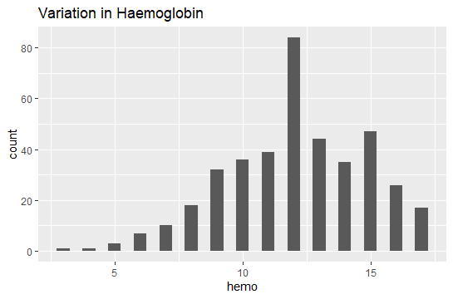

Slide 22
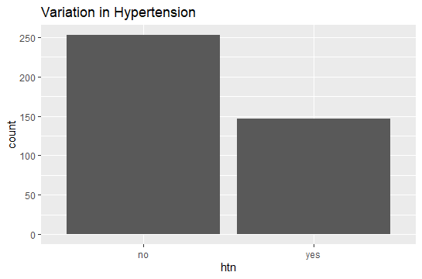

Slide 23
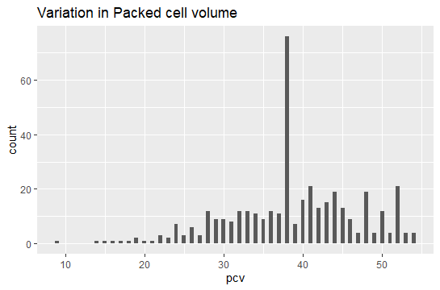

Slide 24
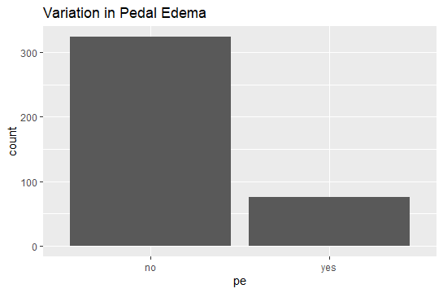

Slide 25
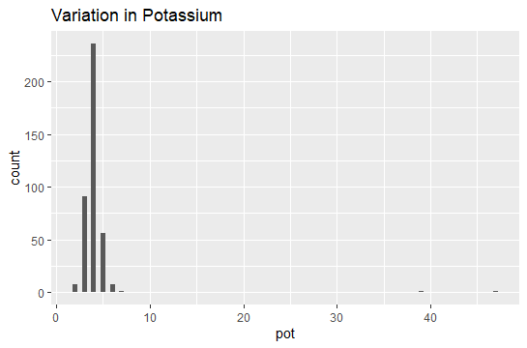

Slide 26
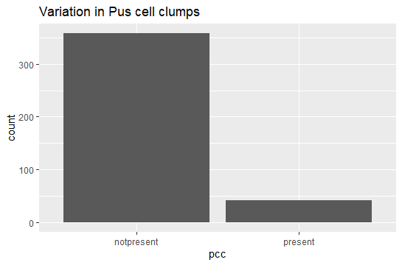

Slide 27
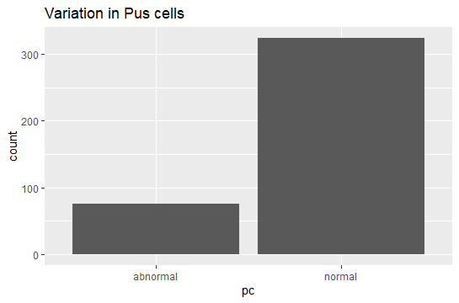

Slide 28
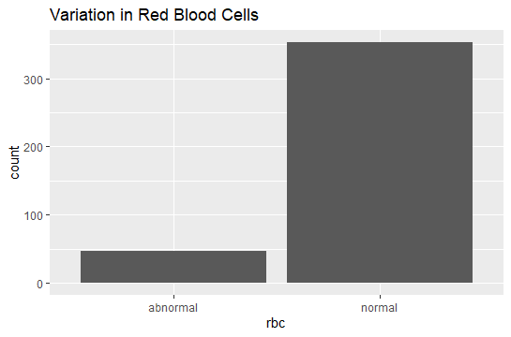

Slide 29
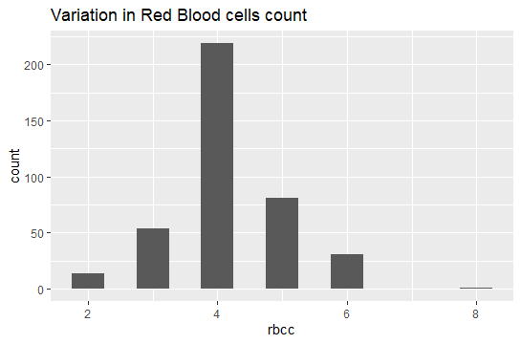

Slide 30
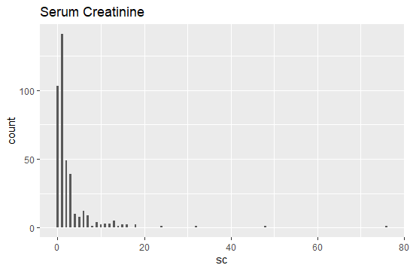

Slide 31
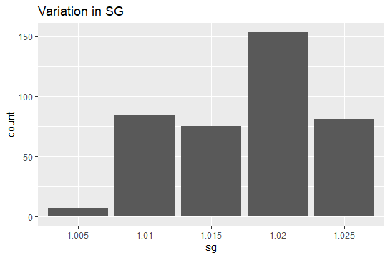

Slide 32
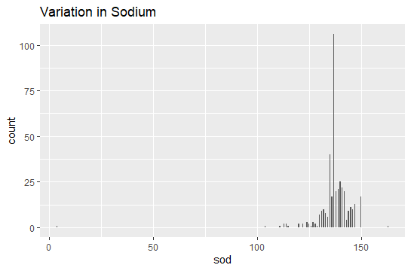

Slide 33
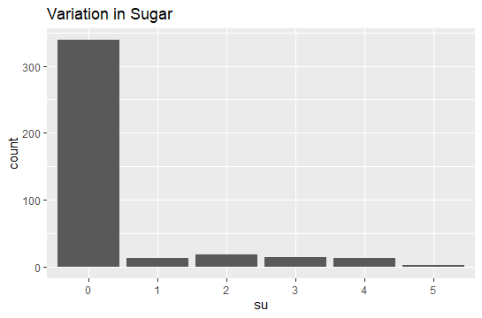

Slide 34
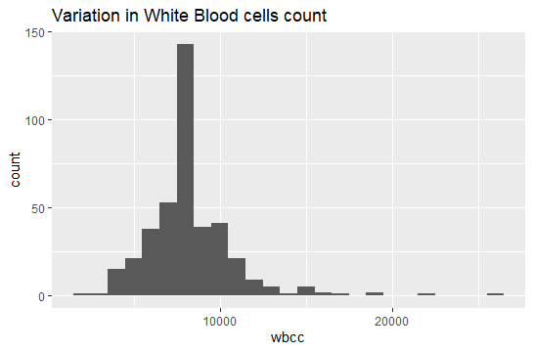

Slide 35
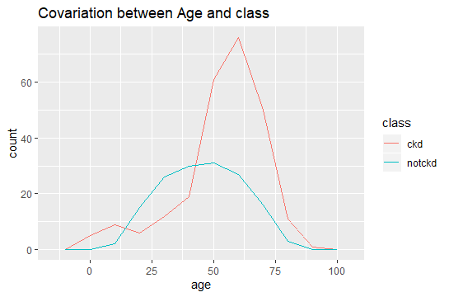

Slide 36
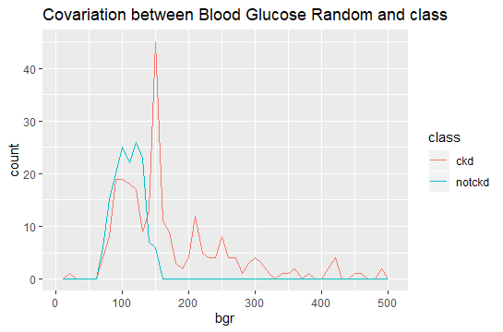

Slide 37
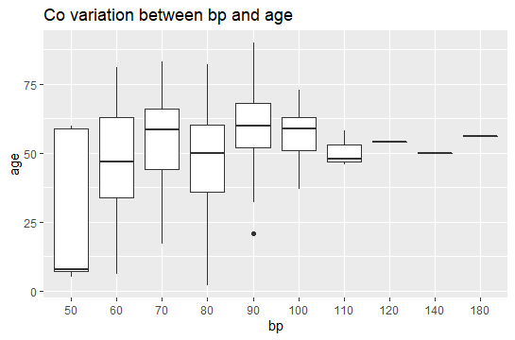

Slide 38
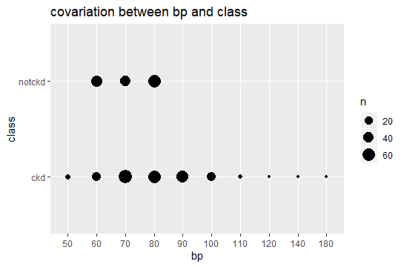

Slide 39
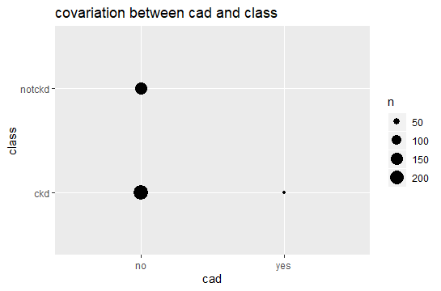

Slide 40
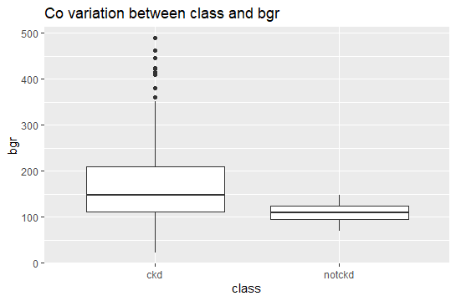

Slide 41
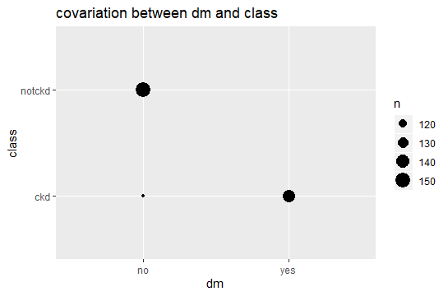

Slide 42
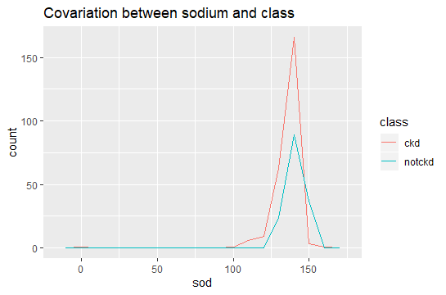

Slide 43
RESEARCH QUESTIONS
Can we predict whether the person involved has chronic kidney disease or not?
Is Age an important factor for chronic kidney disease?
Is high blood pressure a major cause for chronic kidney disease?
4. Does diabetes mellitus increase the occurrence probability of chronic kidney disease?
5. Is coronary artery disease a primary root for chronic kidney disease?

Slide 44
ANALYSIS METHODS
Since our research question deals with the prediction of the presence of Chronic Kidney Disease our results happens to be a categorical variables whether a ckd or not a ckd.
Classification is needed for the categorization of the disease for this purpose we opted for the linear regression and random forest method.

Slide 45
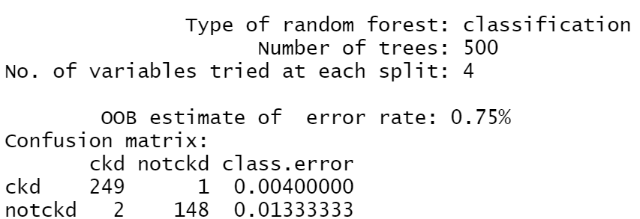
INITIAL RESULTS
RANDOM FOREST:

Slide 46
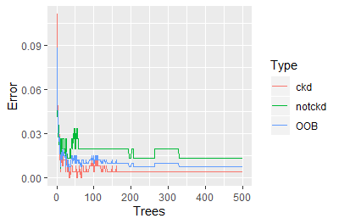
ERROR RATE GRAPH

Slide 47
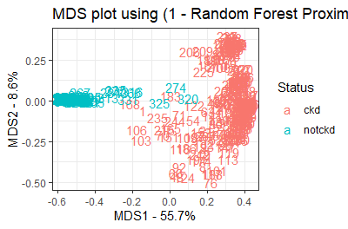
MDS PLOT

Slide 48
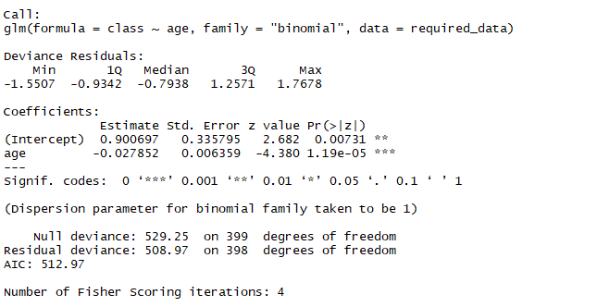
LOGISTIC REGRESSION

Slide 49
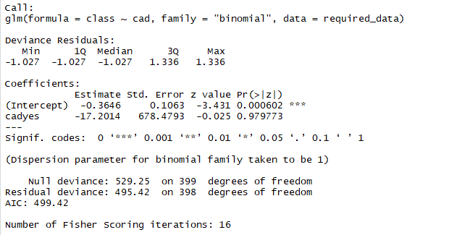

Slide 50
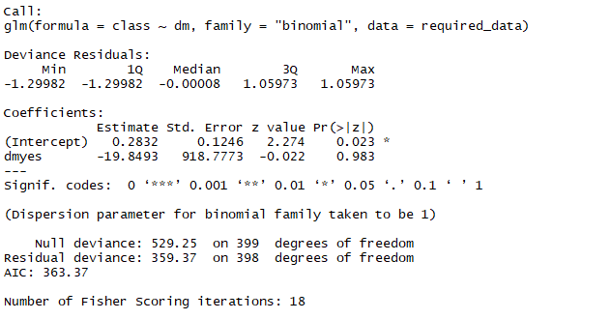

Slide 51
FURTHER ANALYSIS
We are planning to predict the output response using support vector machine classifier.

Slide 52
THANK YOU

